Slide 1





Giới thiệu phương pháp phân tích dữ liệu phiên mã gene theo cấu trúc không gian và theo từng tế bào đơn
Phuc-Loi Luu, PhD
Bioinformatics Team Lead, Pacific Informatics
Loi.lp@pacificinformatics.com.vn
HCMC, 12/08/2023

Slide 2
Contents
0. Self-introduction and Acknowledgement
Human Genome and Next-Generation Sequencing
Bulk RNA Sequencing (RNA-seq)
Single cell RNA Sequencing (scRNA-seq)
Bulk ATAC Sequencing (ATAC-seq)
Single-cell ATAC Sequencing (scATAC-seq)
Discussion: optimization and debugging for scRNA/ATAC-seq

Slide 3
Self-introduction and Acknowledgement

Slide 4




Acknowledgement
All patients who donate samples
All member of Prof. Susan Clark lab
Prof. Susan Clark
Dr Clare
Dr Ruth
Jenny
Wenija
Dilys
Dr Qian
Dr Amanda
Dr Jo
Dr Braydon
Dr Shalima

Slide 5
Acknowledgement Collaborators and Students in Viet Nam
NGUYEN CANH HIEP, MD, PhD
LUONG THI MY HANH, MD, PhD
TRẦN THỊ THANH KHƯƠNG, PhD
CAO THỊ TÀI NGUYÊN, PhD
TRỊNH VẠN NGỮ, PhD
LE MINH THONG, PhD
Bsc. LÊ NHẤT THÔNG
Bsc. PHẠM MAI TÂM
Bsc. NGUYỄN TẤN THANH GIANG
Bsc. NGUYỄN ANH XUÂN
Bsc. LE VAN HIEU
Bsc. NGUYỄN MINH HOÀNG
Bsc. TRẦN BÁ THIÊN
ONG PHUC THINH, MD
NGUYEN HUY THINH, MD
DAO NGOC BAC, MD, Msc
NGUYEN PHAN XUAN TRUONG, MD
TRAN NGUYEN TRONG PHU, MD
All member of VnPathoinformatics group

Slide 6


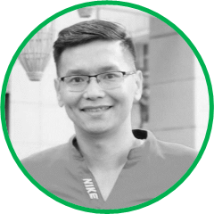



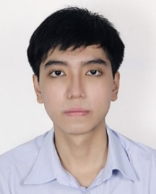


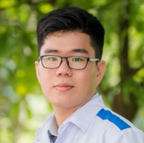

The Bioinformatics Team Members
Name and Role | Profile Picture | Profile Picture | Name and Role
Luu Phuc-Loi, PhD Team Lead |  |  | Nguyen Viet Tuan, PhD Consultant
Du Hoang Tien, Msc. Associate |  |  | Phan Vo Thu Nga, Bsc. Associate
Nguyen Le Duc Minh, Dr. Genetics Consultant |  |  | Tran Thien Tan, Bsc. Technician
Dao Khuong Duy, Bsc. Technician Nguyen Minh Hoang, Bsc. Technician |  |  | Le Van Hieu, Bsc. Technician

Slide 7
Human Genome and Next-Generation Sequencing

Slide 8
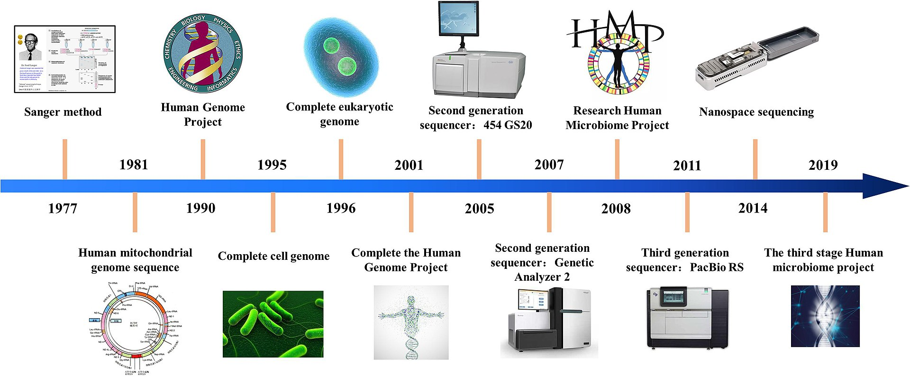
High-throughput sequencing (HTS) methods
https://en.wikipedia.org/wiki/DNA_sequencing

Slide 9
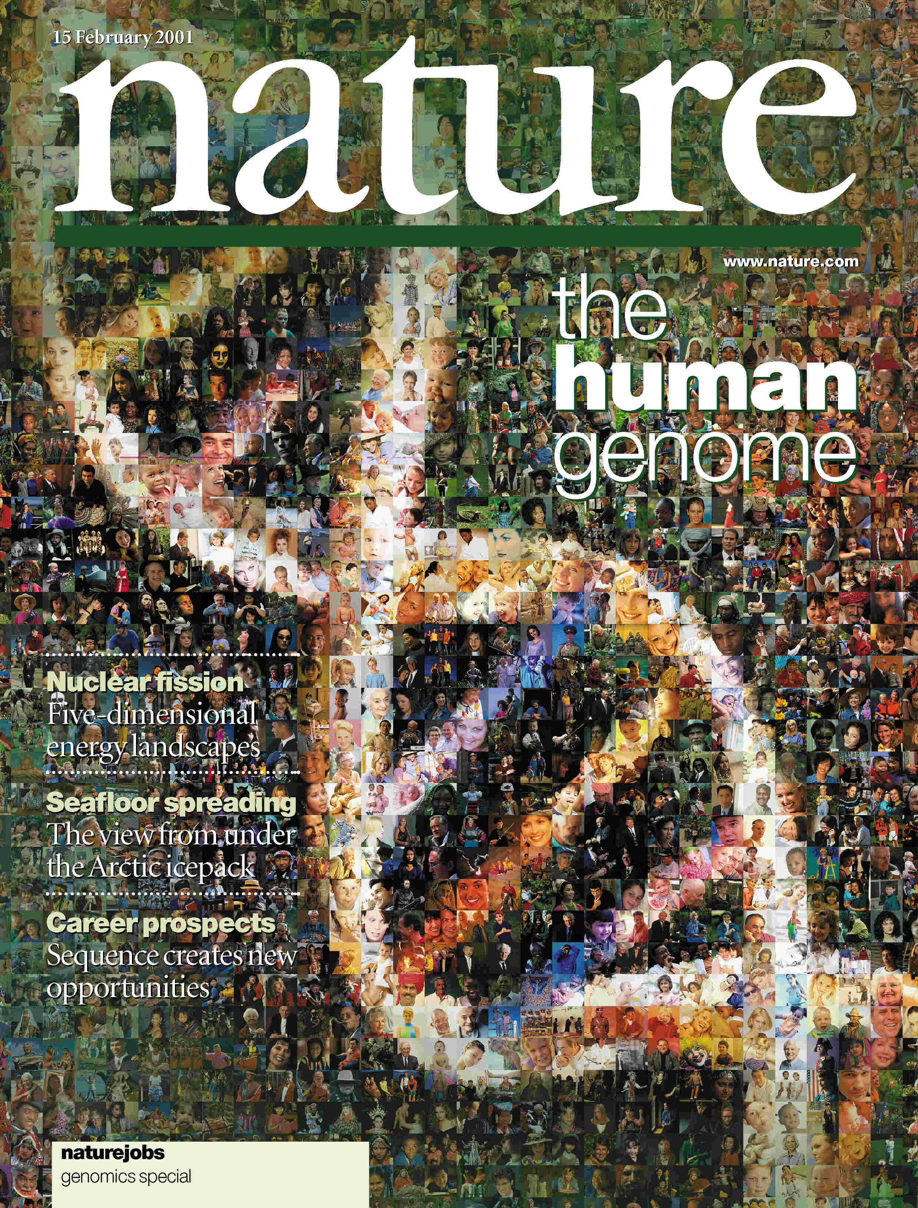

February 2001: Papers Reporting
Draft Sequence of Human Genome
HGP Paper
Venter/Celera Paper

Slide 10
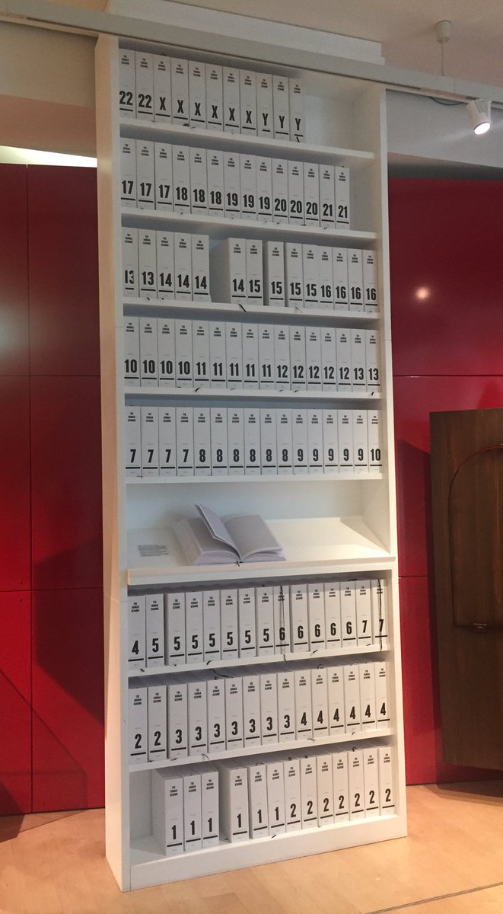
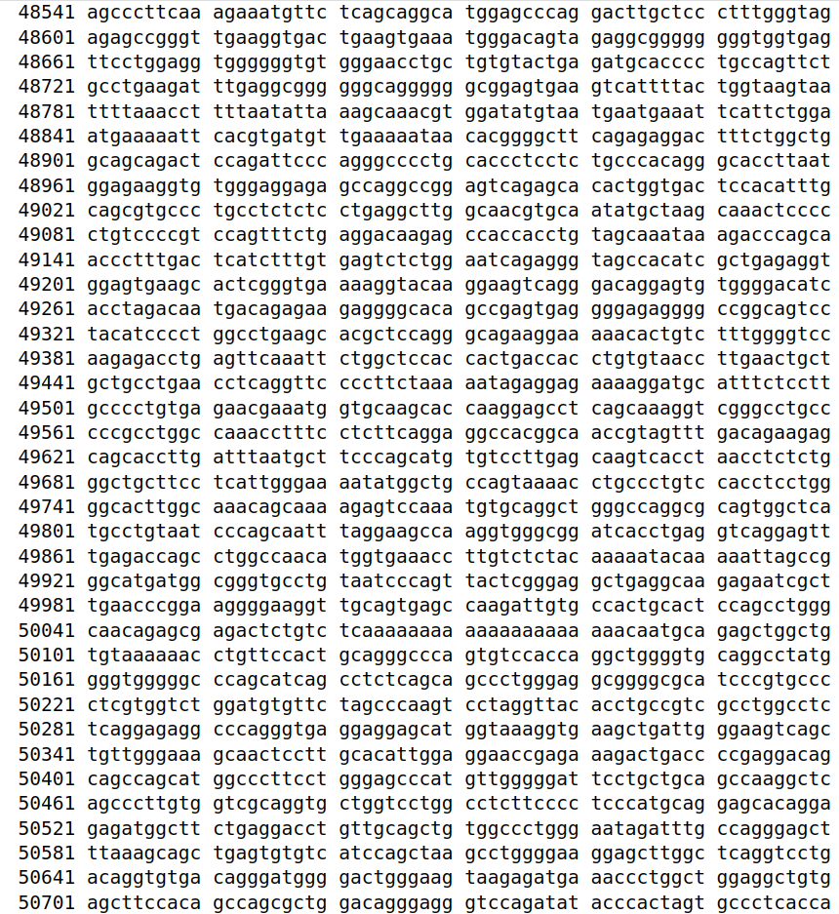
https://www.ncbi.nlm.nih.gov/nuccore/806904736

Slide 11
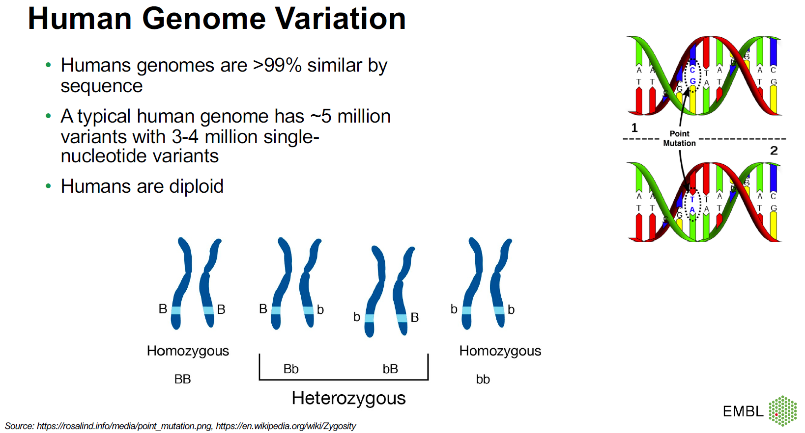
Tobias Rausch

Slide 12
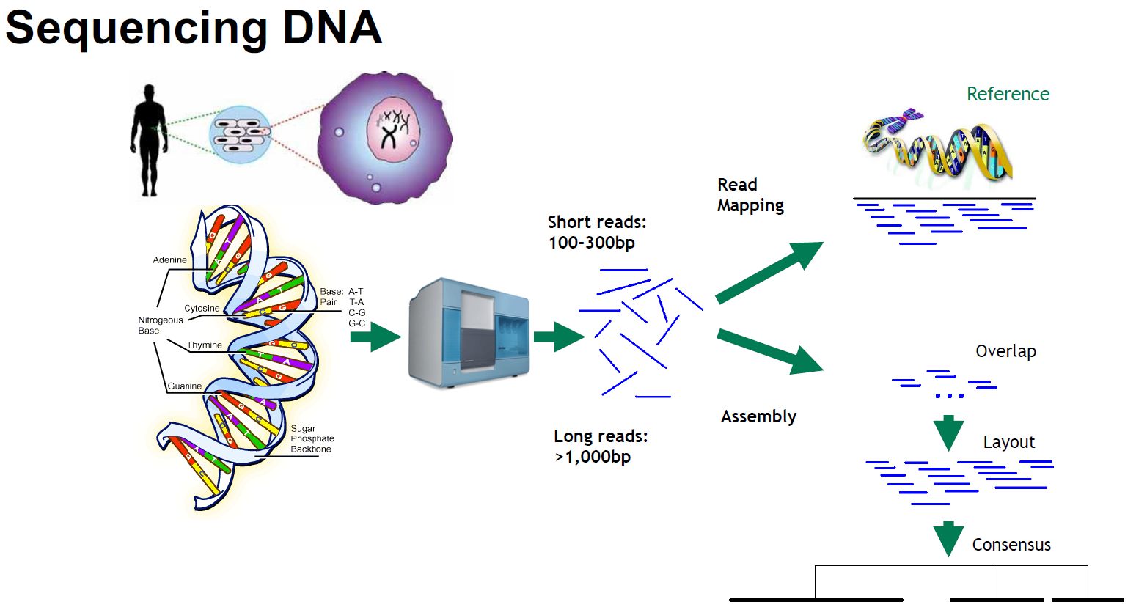
Tobias Rausch

Slide 13
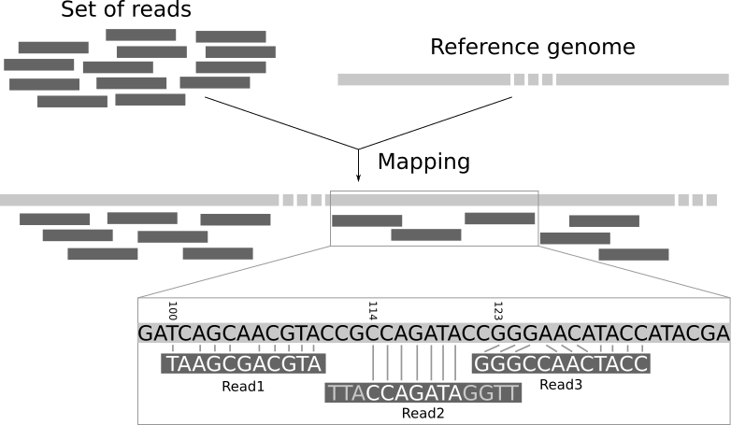
Read Alignment

Slide 14
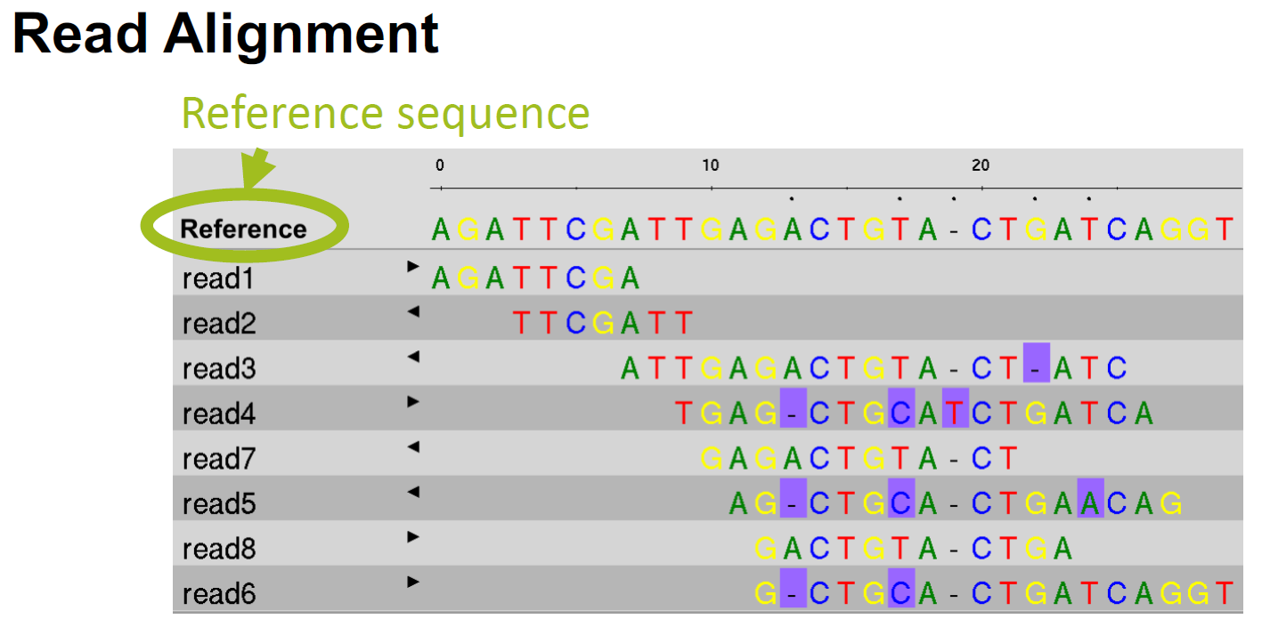
Tobias Rausch

Slide 15
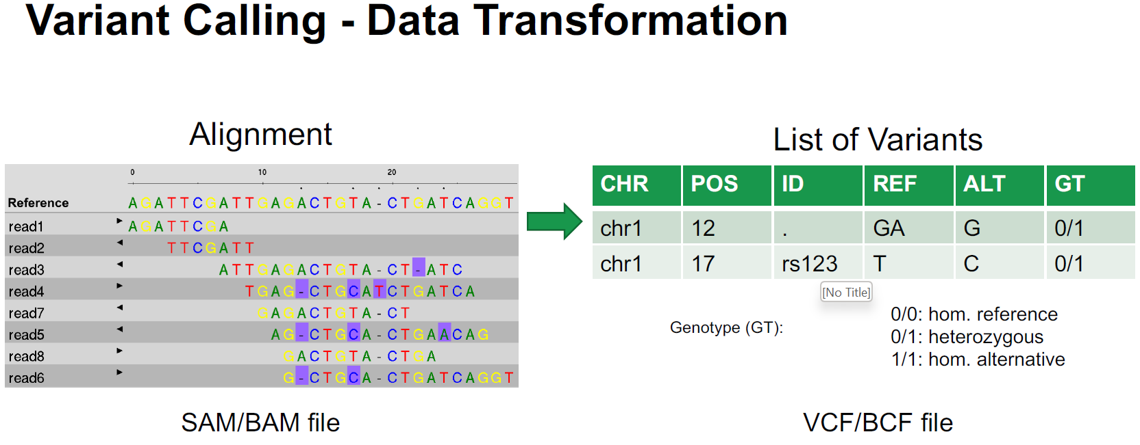
Tobias Rausch

Slide 16
Bulk RNA Sequencing (RNA-seq)

Slide 17
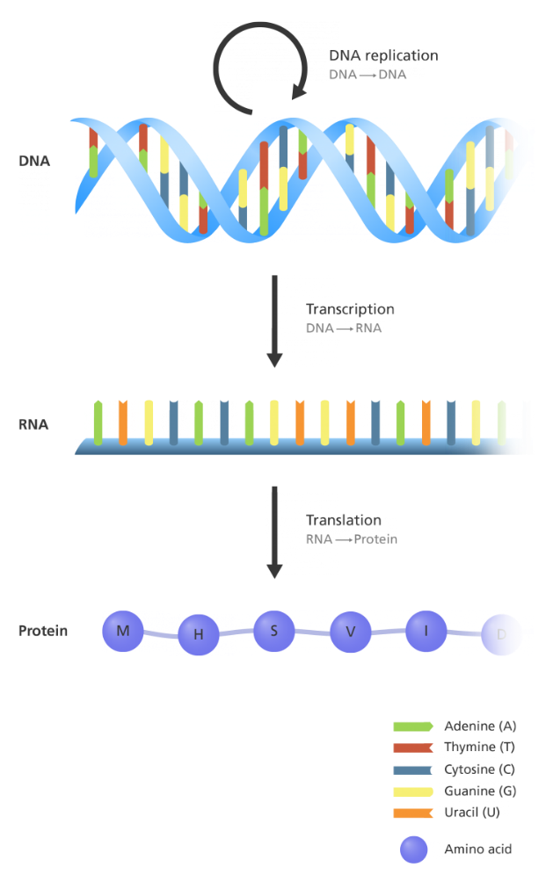
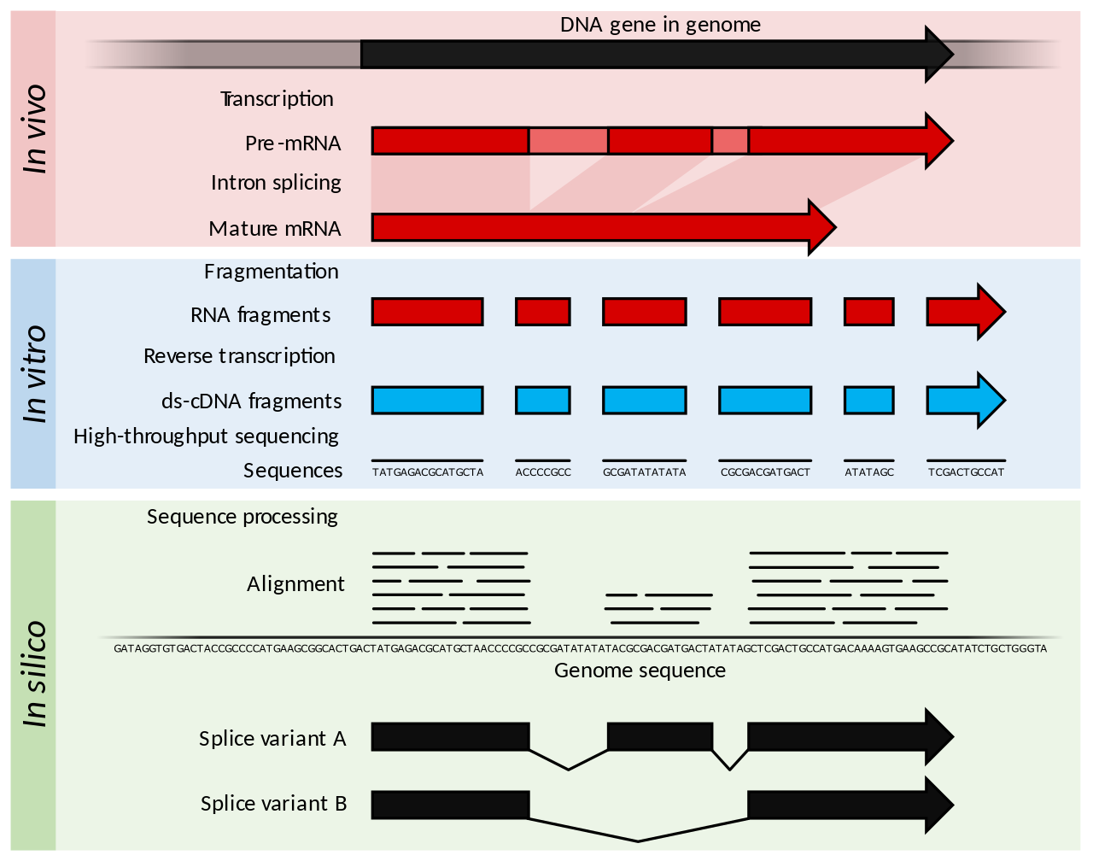
What is RNA sequencing (RNA-seq)?
https://www.yourgenome.org/facts/what-is-the-central-dogma/
https://en.wikipedia.org/wiki/RNA-Seq

Slide 18
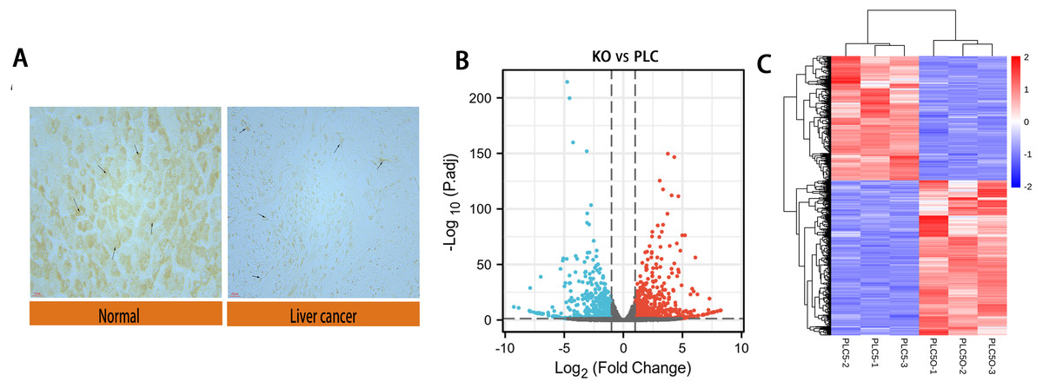
What is RNA sequencing (RNA-seq)?
Figure: Differential expression of DAPK1 and volcano plot and heat maps of differential genes.
(A) Relative expression of DAPK1 compared to normal liver tissue samples. (B, C) Volcano plot and heat map showing the 732 differentially expressed genes. The color red indicates upregulated genes, and blue indicates downregulated genes. PLC, PLC/PRF/5 cells; KO, DAPK1-knockout PLC/PRF/5 cells. padj <0.5, logFC >1.
https://www.yourgenome.org/facts/what-is-the-central-dogma/

Slide 19
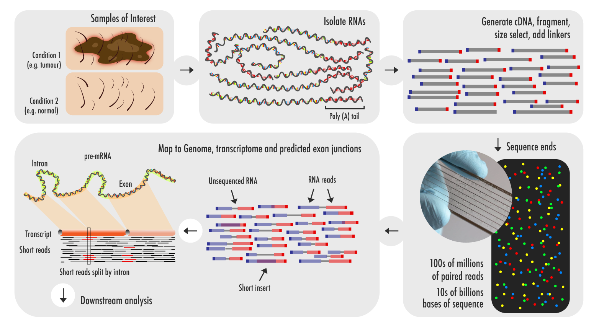
What is RNA sequencing (RNA-seq)?
Figure. A workflow for RNA-seq. Credit: Technology Networks.

Slide 20
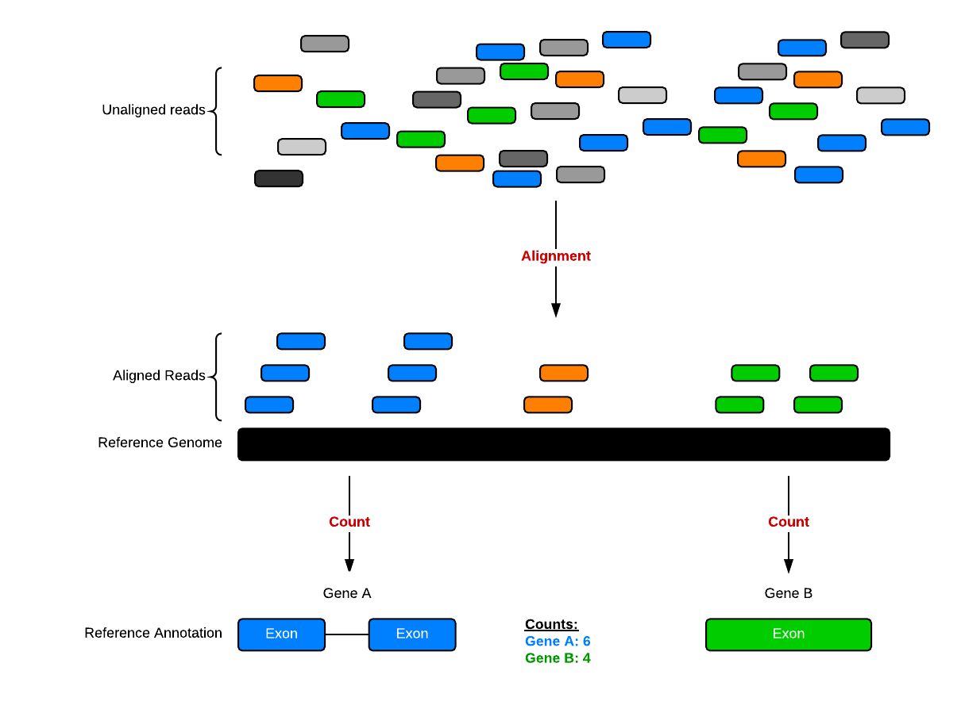
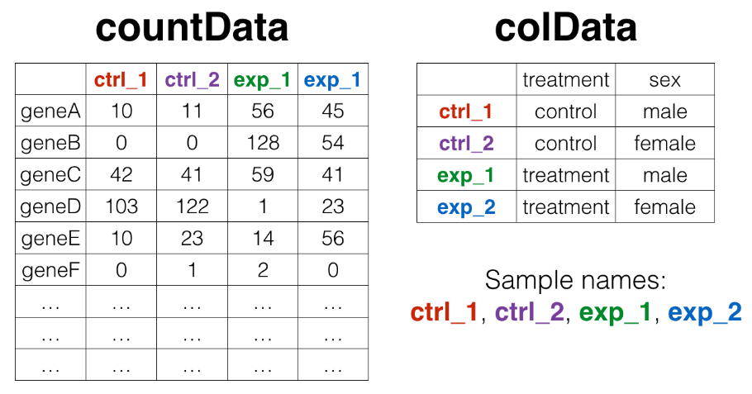
How can RNA sequencing quantify gene expression?
http://bioconnector.github.io/bims8382/r-rnaseq-airway.html

Slide 21
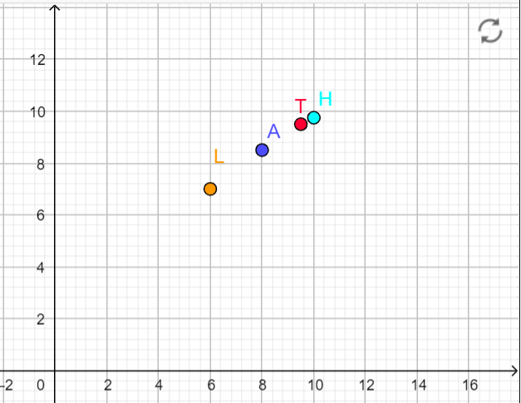
Data of life
 | Name | Math | English
1 | Kim Anh | 8 | 8.5
2 | Hiep | 10 | 9.75
3 | Hanh | 9.75 | 10 (French)
4 | Loi | 6 | 7
5 | Truong | 9.5 | 9.5
English
Math

Slide 22
Data of life
 | Name | Gender | Age | Math | English | History | isDoc
1 | Kim Anh | f | 16 | 8 | 8.5 | 10 | No
2 | Hiep | m | 39 | 10 | 9.75 | 6 | yes
3 | Hanh | f | 18 | 9.75 | 10 (French) | 9.5 | yes
4 | Loi | m | 41 | 6 | 7 | 8 | No
5 | Truong | m | 34 | 9.5 | 9.5 | 9 | yes
PC2 (14%)
PC1 (62%)

Slide 23
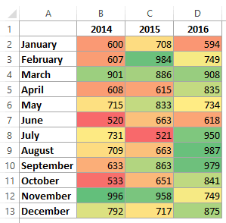
Heatmap

Slide 24
Single cell RNA Sequencing (scRNA-seq)

Slide 25
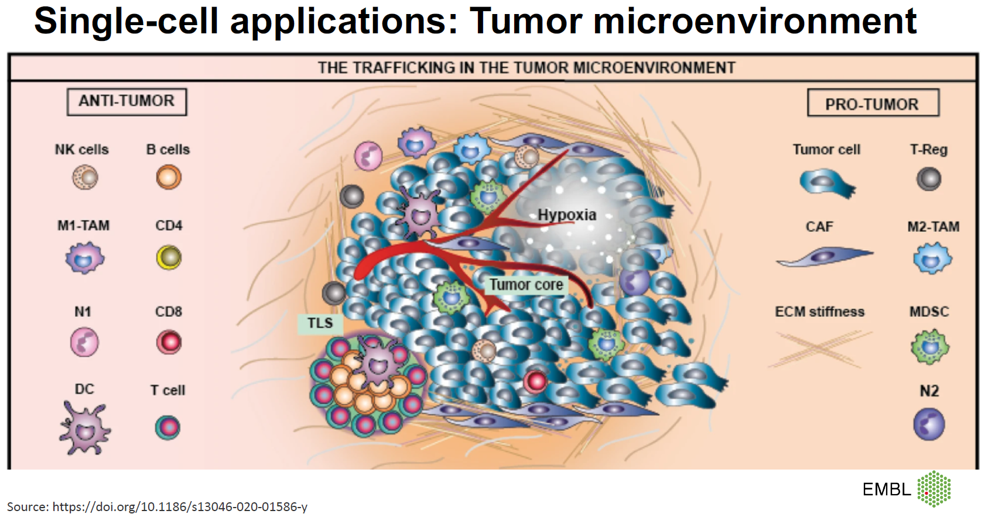
Tobias Rausch

Slide 26
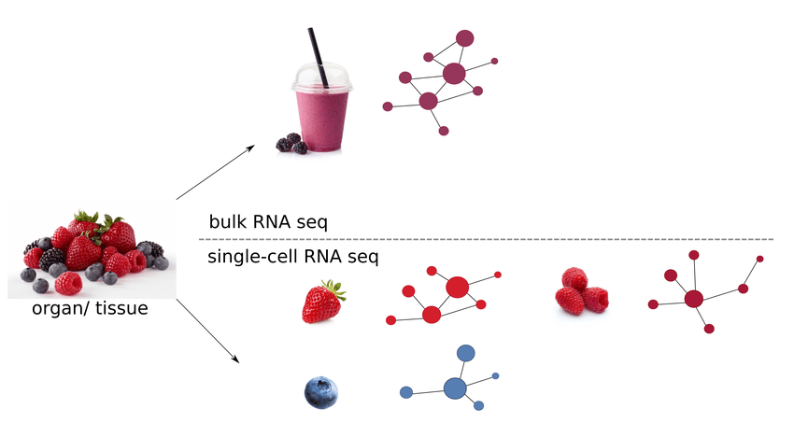
Bulk RNA-seq vs Single-cell RNA-seq
DOI:10.1101/2021.04.02.438193

Slide 27
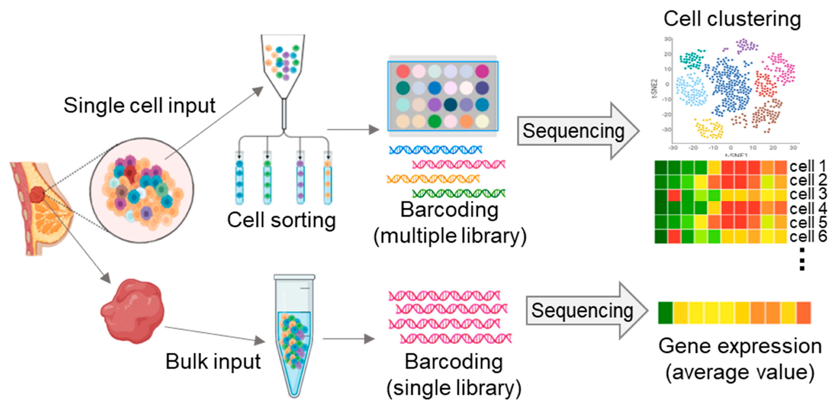
Bulk RNA-seq vs Single-cell RNA-seq
DOI:10.3390/ijms23010216

Slide 28
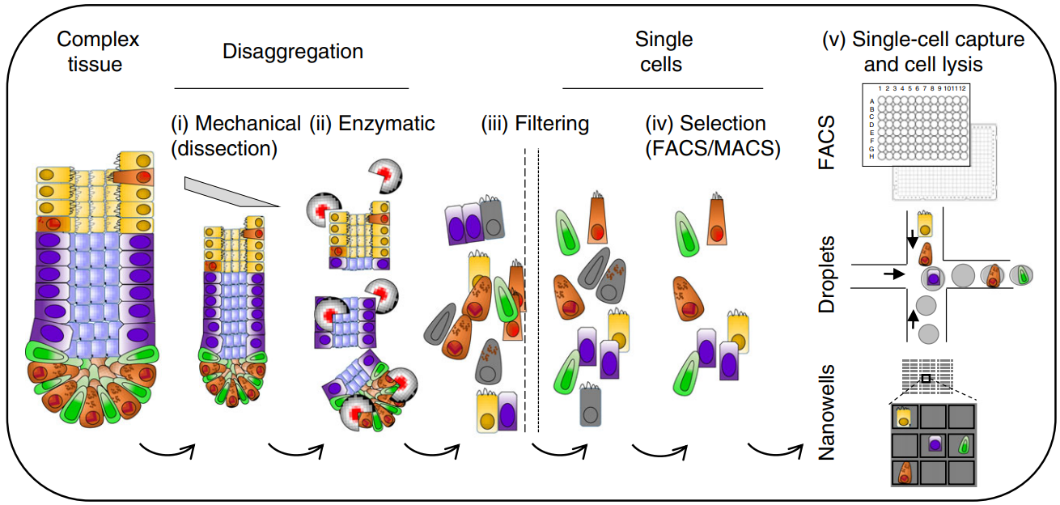
Single-cell RNA-seq: sample prepraration
DOI:10.1038/s41596-018-0073-y

Slide 29
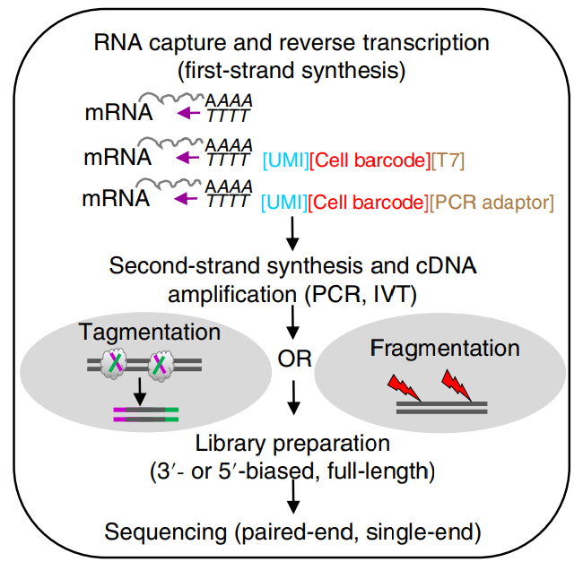
Single-cell RNA-seq: sequencing
DOI:10.1038/s41596-018-0073-y

Slide 30
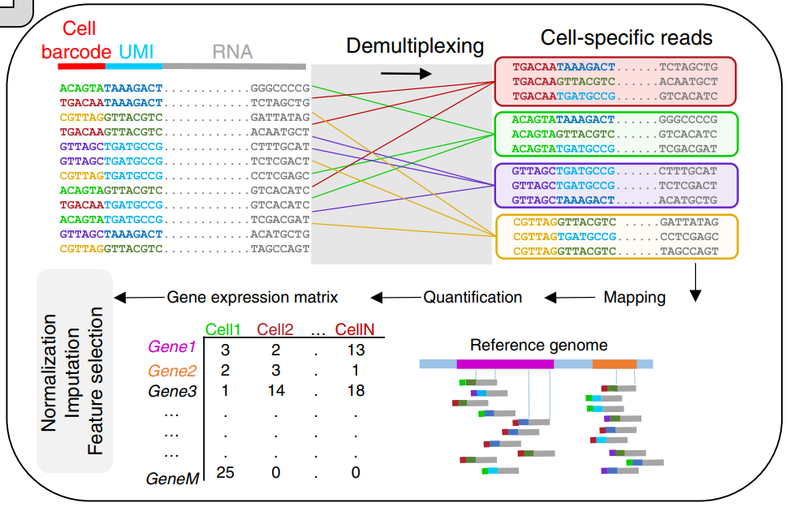
Single-cell RNA-seq: data processing
10.1038/s41596-018-0073-y

Slide 31
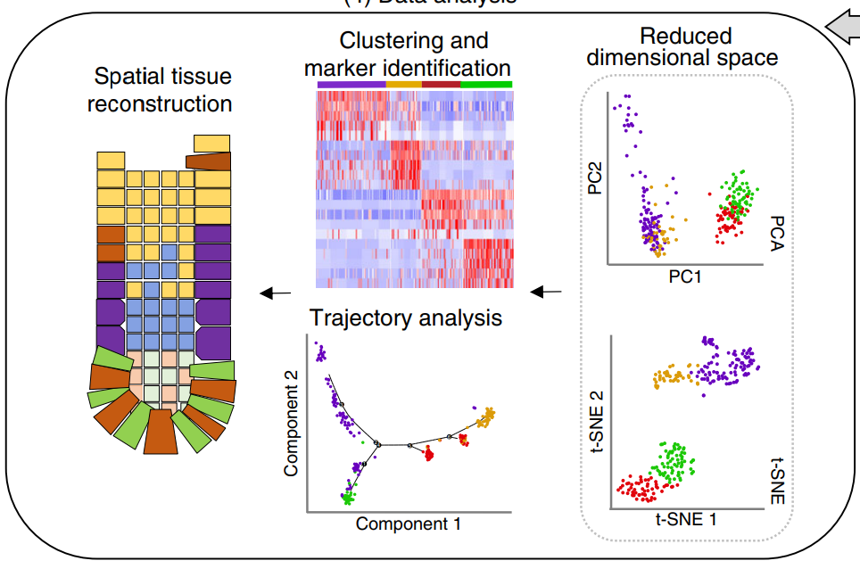
Single-cell RNA-seq: data processing
10.1038/s41596-018-0073-y

Slide 32
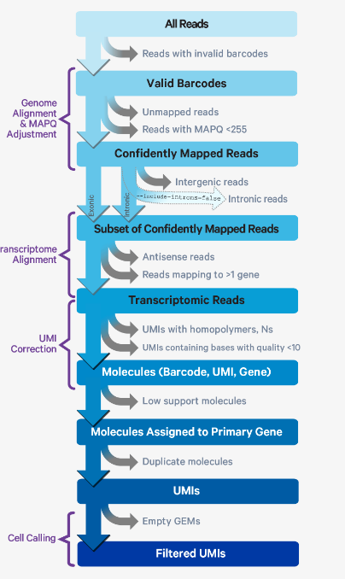
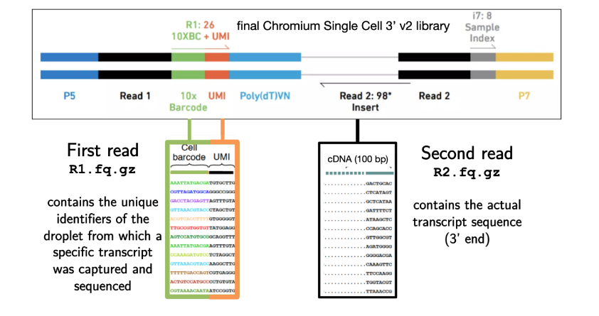
Upstream Analysis Process
Input: Fastq
Individual sample
CellRanger reports
CellRanger Multi-QC report
Sequencing multi-QC report
Cellranger Pipeline
https://support.10xgenomics.com/single-cell-gene-expression/software/pipelines/latest/algorithms/overview#cell_calling
Notes:
Raw data (BCL fles) from Illumina Novaseq6000 platform was converted to fastq fles using Illumina-implemented software bcl2fastq (v2.19.0.316).

Slide 33
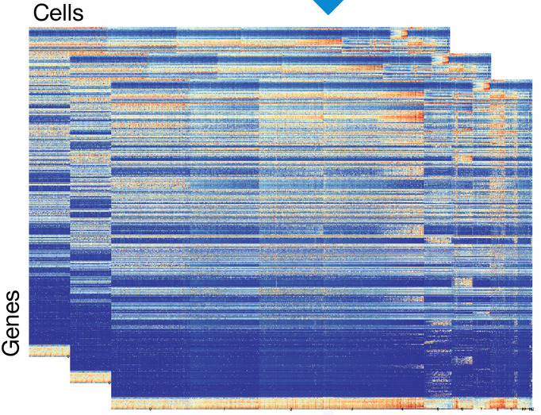
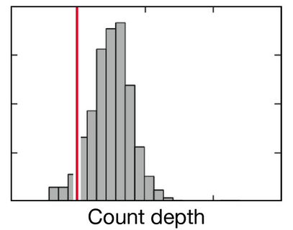
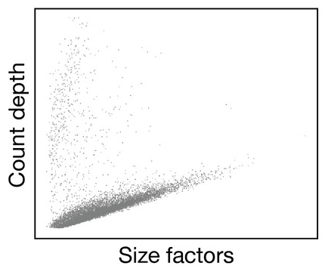


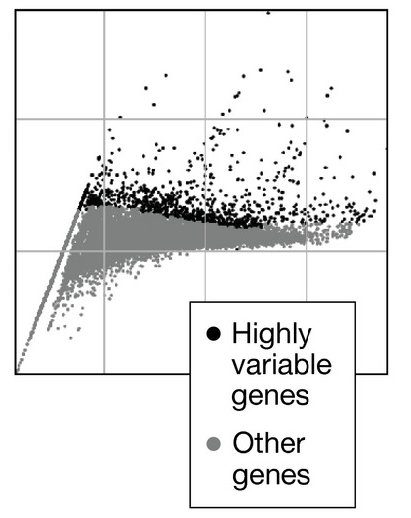
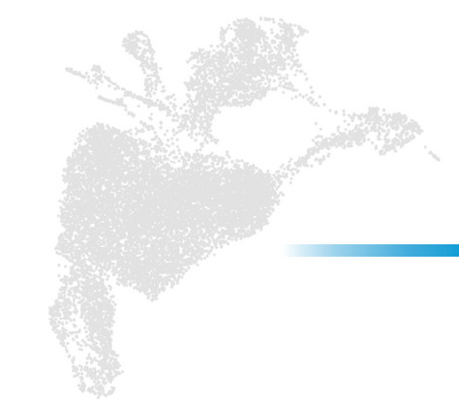
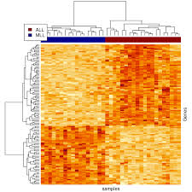
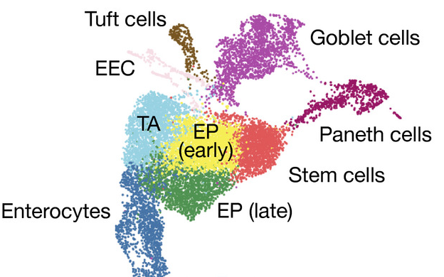

D A T A P R E - P R O C E S S I N G
Quality control
Normalization
Raw data process
Alignment to transcriptome
Quantification into Raw Counts Matrix
Feature selection
Visualization
Differentially gene expressed features (cluster biomarkers)
Gene Ontology analysis
Cluster
annotation
Clustering
SUBSETING
Pseudo-bulk differential gene expression analysis
D O W N S T R E A M A N A L Y S I S
Notes:
STT :
1. GENE expression
2. SNV
3. SNV
feature selection: xem lại, phải hiểu ý nghĩa ghi đưa hình lên, …
ở phần dimensionality reduction, đưa visualization lên trên, bỏ hình PC đi
QC: biết nó sai, thì remove đi, chứ không có sửa
Data correction: bias bởi tuổi tác, là không remove đi, chỉ chỉnh sửa lại,
(input, output như nào ?
Cellranger: sử dụng tools nào, aligner nào ( bwa, Bowtie2)
trajectory inference: nhìn vào hình, biết ở đâu là cell of origin ? Kết quả như nào.

Slide 34
Bulk ATAC-seq

Slide 35
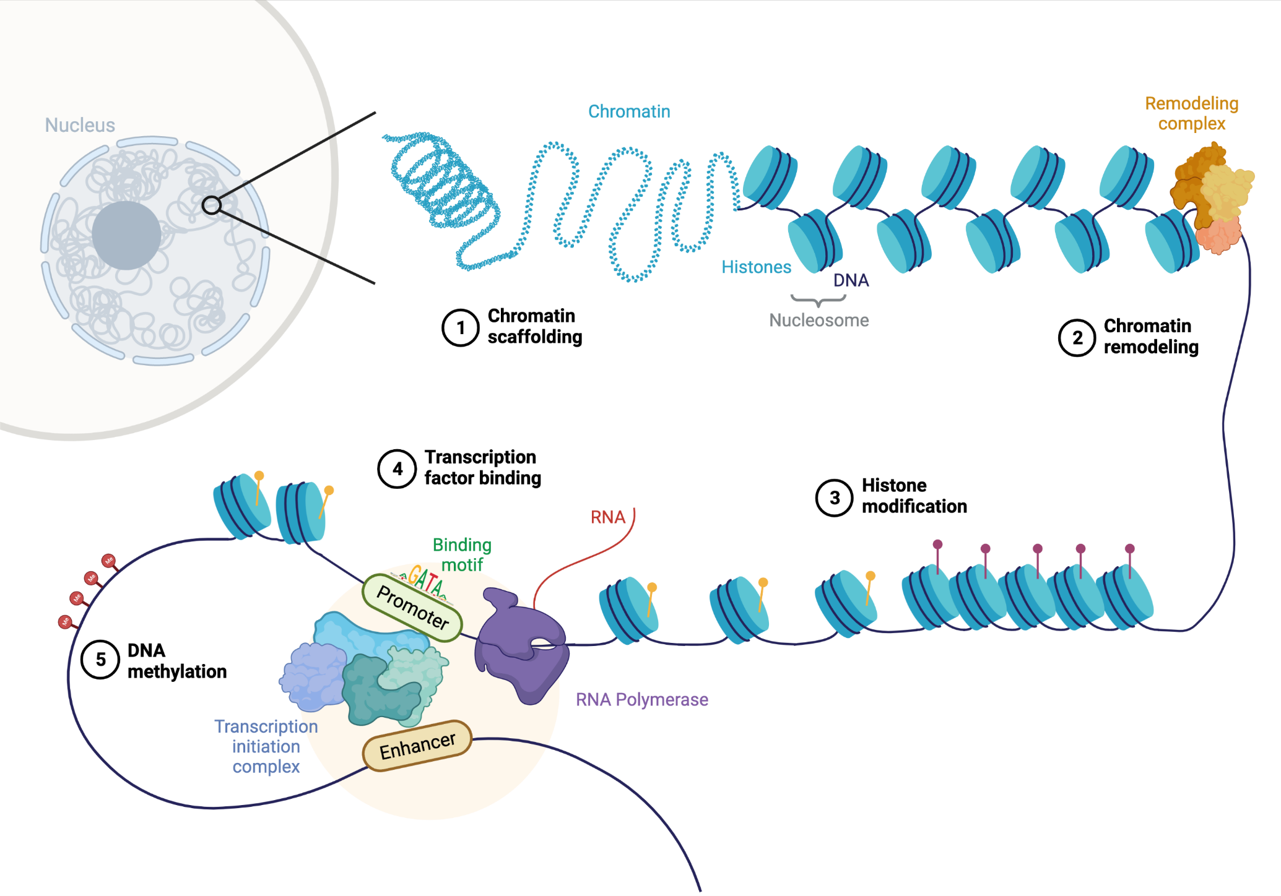
Figure. Overview of mechanisms influencing chromatin accessibility. Created with BioRender.com.

Slide 36
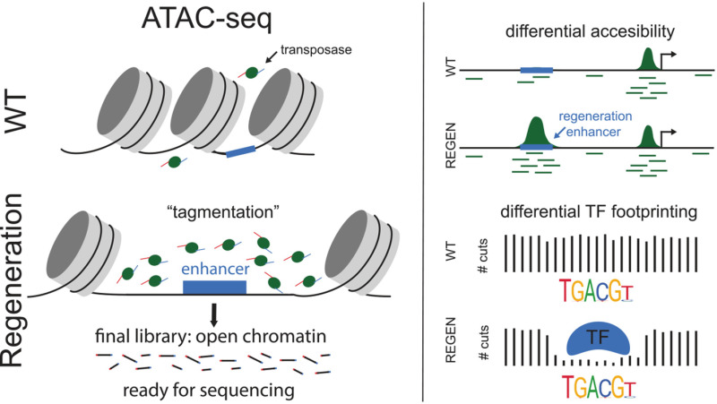
Figure. Overview of an ATAC-seq seq experiment to assay regeneration-responsive chromatin.
https://www.ncbi.nlm.nih.gov/books/NBK586944/figure/ch29.Fig1/?report=objectonly

Slide 37
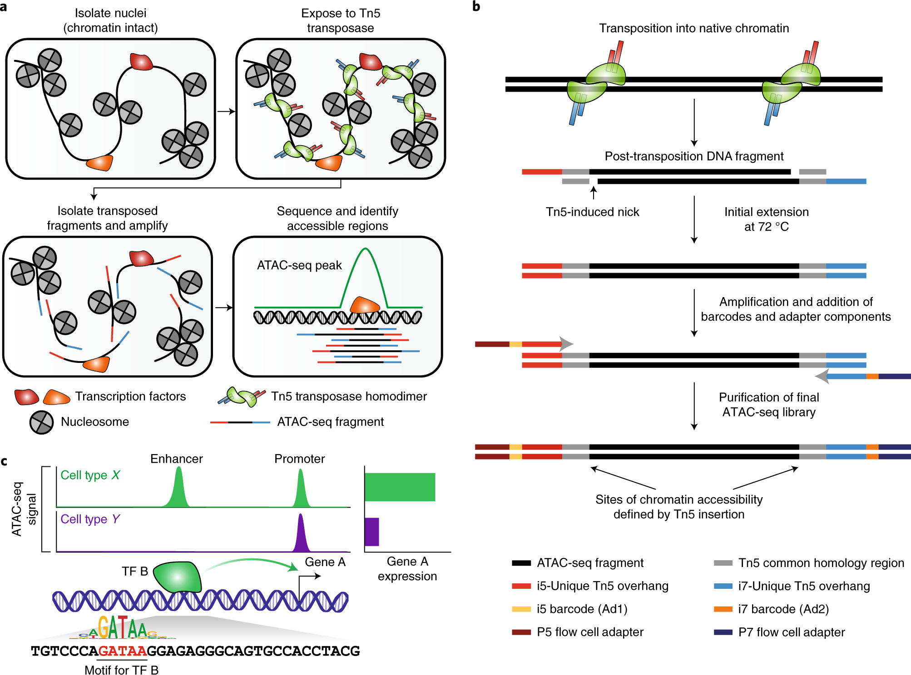
Figure. Schematic of the ATAC-seq transposition reaction and library preparation.
https://www.nature.com/articles/s41596-022-00692-9

Slide 38
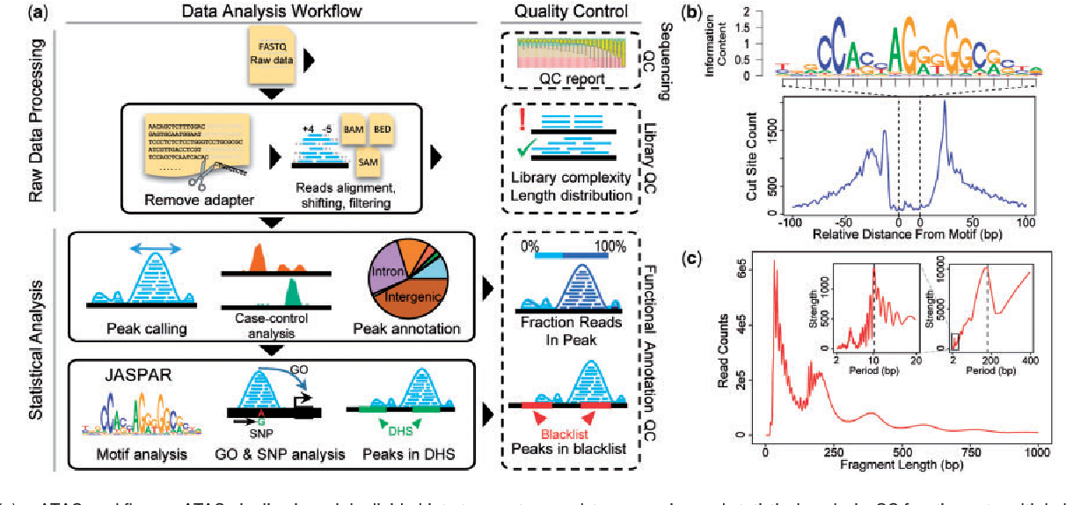
Bulk ATAC-seq analysis
DOI:10.1093/bioinformatics/bty141

Slide 39
Single-cell ATAC-seq

Slide 40
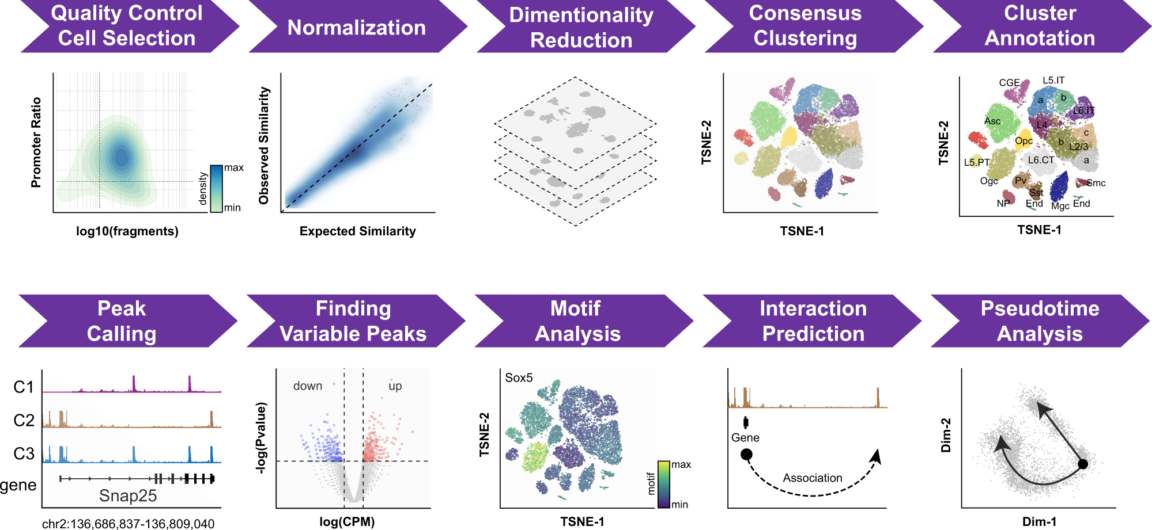
scATAC-seq analysis
Figure: Schematic overview of SnapATAC analysis workflow.

Slide 41
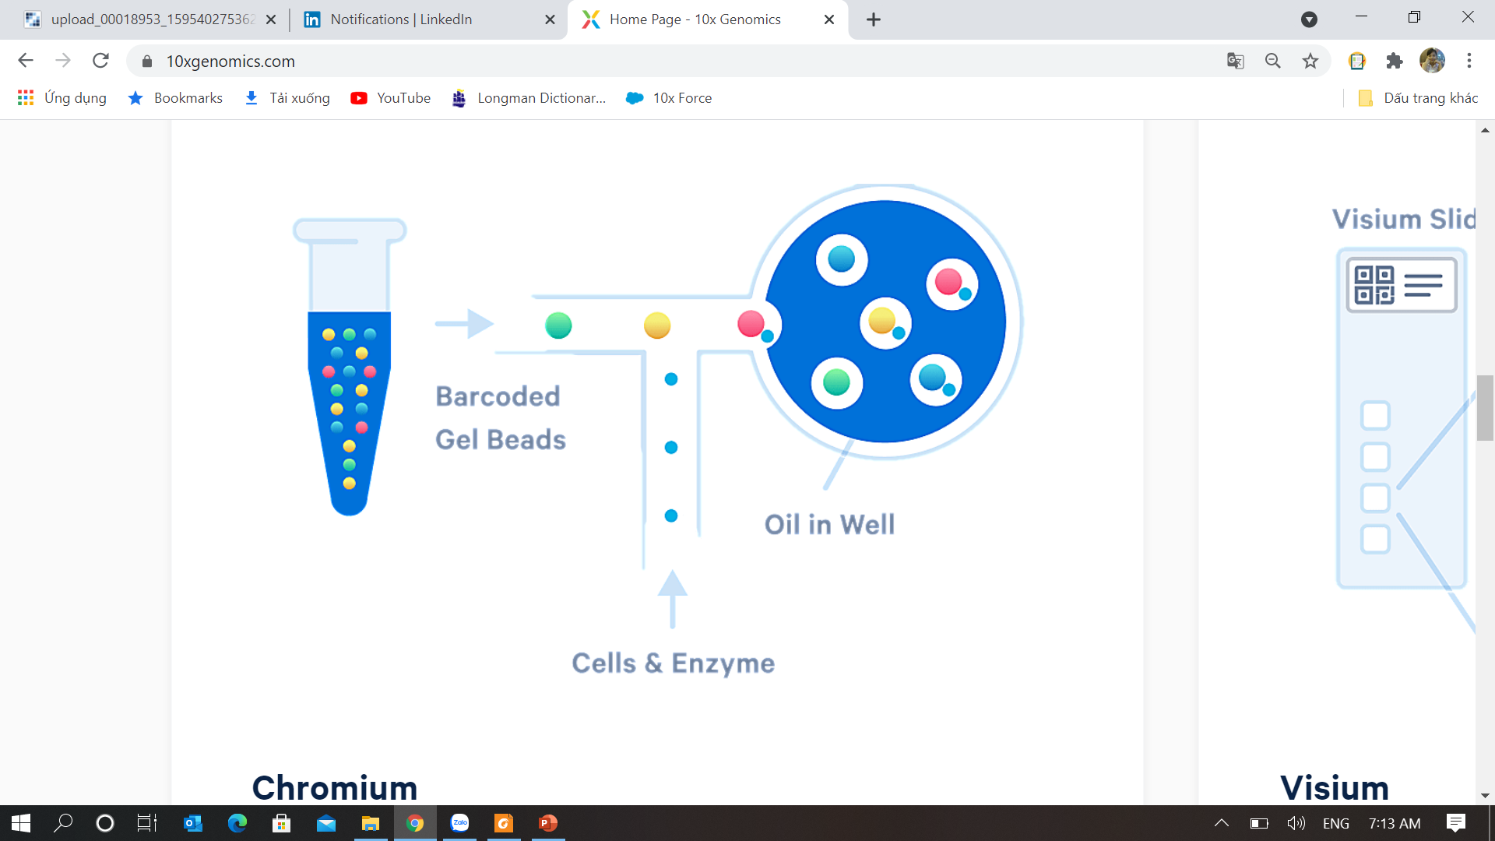

Chromium Single Cell

Slide 42
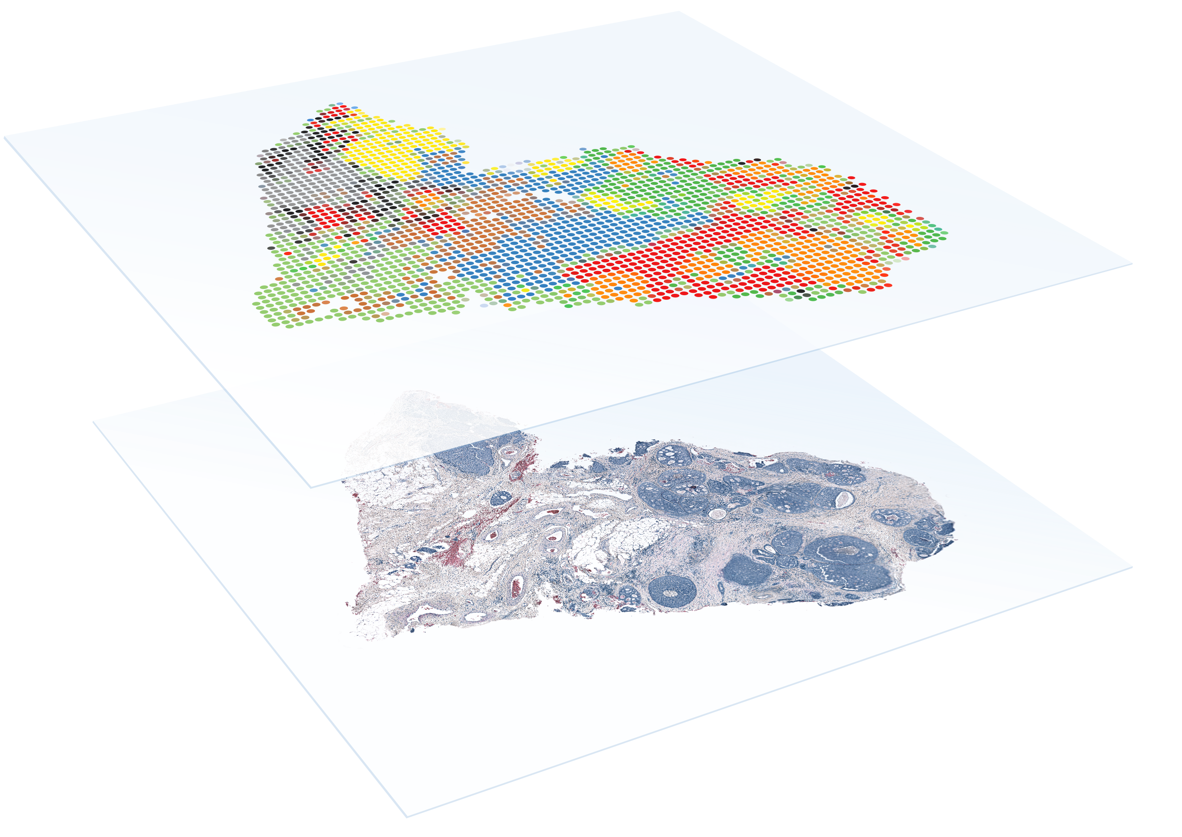

Slide 43
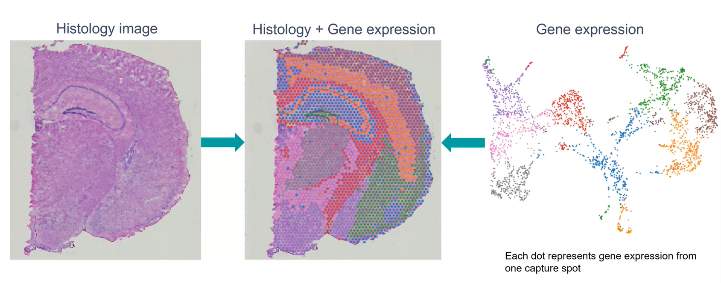
Spatial transcriptomics with Visium
Where do active T cells Locate?

Slide 44
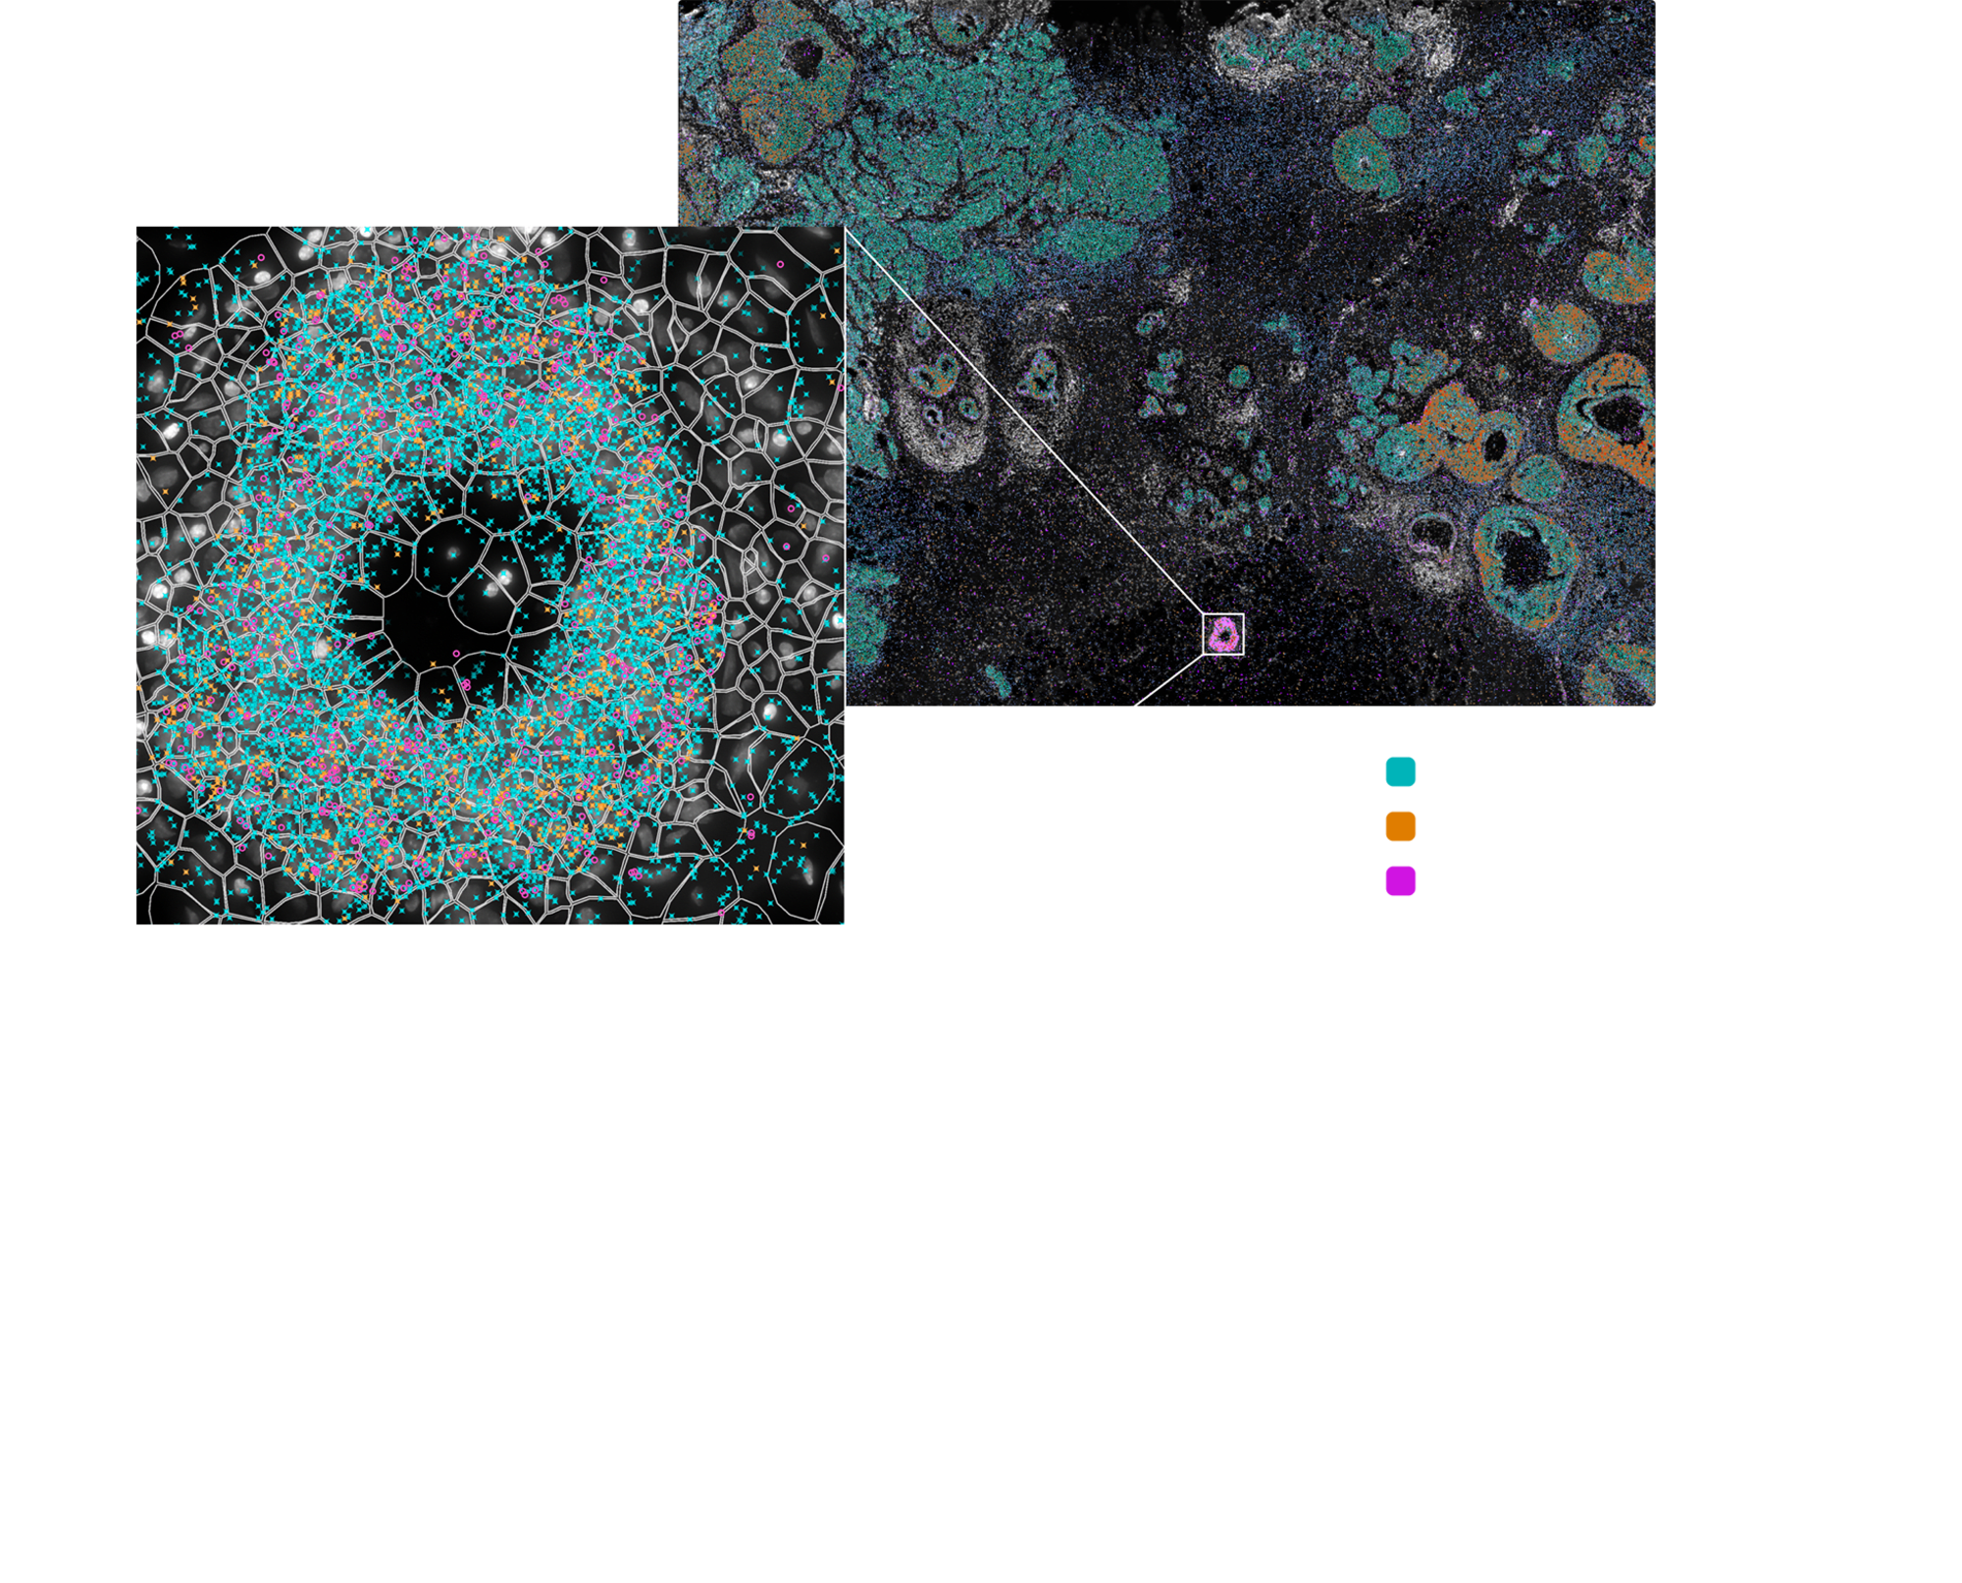
Xenium In Situ

Slide 45
THANK YOU FOR YOUR ATTENTION and Q&A!
Please contact:loi.lp@pacificinformatics.com.vn
For further information!

